Slide 1
Distributed Systems
(3rd Edition)
Chapter 02: Architectures
Version: March 20, 2022

Slide 2
Architectural styles
Architectures: Architectural styles
Basic idea
A style is formulated in terms of
(replaceable) components with well-defined interfaces
the way that components are connected to each other
the data exchanged between components
how these components and connectors are jointly configured into a system.
2 / 36

Slide 3
Architectural styles
Architectures: Architectural styles
Component
A component is a modular unit with well-defined required and provided interfaces that is replaceable within its environment.
Connector
A mechanism that mediates communication, coordination, or cooperation among components. Example: facilities for (remote) procedure call, messaging, or streaming.
3 / 36

Slide 4
Architectural styles
Architectures: Architectural styles
Classification of architectural styles
Several styles have by now been identified
Layered architectures
Object-based architectures
Resource-centered architectures
Event-based architectures
4 / 36

Slide 5
Architectures: Architectural styles
Layered architectures
Layered architecture
Different layered organizations
Request/Response
downcall
One-way call
Layer N
Layer N
Layer N
Layer N-1
Layer N-1
Layer N-1
Handle
Upcall
Layer N-2
Layer N-2
Layer 2
Layer N-3
Layer 1
(a)
(b)
(c)
5 / 36
Notes:
components are organized in a layered fashion where a component at layer Lj can make a downcall to a component at a lower-level layer Li (with i < j) and generally expects a response. Only in exceptional cases will an upcall be made to a higher-level component.

Slide 6

Architectures: Architectural styles
Layered architectures
Example: communication protocols
Protocol, service, interface
Party A
Party B
Layer N
Layer N
Interface
Service
Layer N-1
Layer N-1
Protocol
Layered communication protocols
6 / 36

Slide 7
Architectures: Architectural styles
Layered architectures
Two-party communication
Server
1 from socket import *
2 s = socket(AF_INET, SOCK_STREAM)
3 (conn, addr) = s.accept() # returns new socket and addr. client
4 while True: # forever
data = conn.recv(1024) # receive data from client
5
6 if not data: break # stop if client stopped
7 conn.send(str(data)+"*") # return sent data plus an "*"
8 conn.close() # close the connection
Client
1 from socket import *
2 s = socket(AF_INET, SOCK_STREAM)
3 s.connect((HOST, PORT)) # connect to server (block until accepted)
4 s.send(’Hello, world’)
5 data = s.recv(1024)
6 print data
7 s.close()
# send some data
# receive the response # print the result
# close the connection
Layered communication protocols
7 / 36

Slide 8
Architectures: Architectural styles
Layered architectures
Application Layering
Traditional three-layered view
Application-interface layer contains units for interfacing to users or external applications
Processing layer contains the functions of an application, i.e., without specific data
Data layer contains the data that a client wants to manipulate
through the application components
Application layering
6 / 36

Slide 9
Architectures: Architectural styles
Layered architectures
Application Layering
Traditional three-layered view
Application-interface layer contains units for interfacing to users or external applications
Processing layer contains the functions of an application, i.e., without specific data
Data layer contains the data that a client wants to manipulate
through the application components
Observation
This layering is found in many distributed information systems, using traditional database technology and accompanying applications.
Application layering
6 / 36

Slide 10
Architectures: Architectural styles
Layered architectures
Application Layering
Example: a simple search engine
User interface
User-interface level
HTML page containing list
Keyword expression
HTML
generator
Processing level
Query generator
Ranked list of page titles
Ranking algorithm
Database queries
Web page titles
with meta-information
Database with Web pages
Data level
Application layering
7 / 36

Slide 11

Object-based style
Architectures: Architectural styles Object-based and service-oriented architectures
Essence
Components are objects, connected to each other through procedure calls. Objects may be placed on different machines; calls can thus execute across a network.
State
Object
Object
Method
Object
Method call
Object
Object
Interface
Encapsulation
Objects are said to encapsulate data and offer methods on that data without revealing the internal implementation.

Slide 12
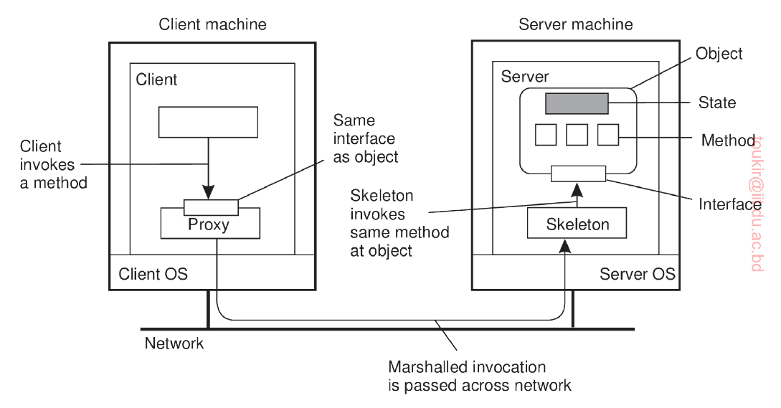
Object-based style
Architectures: Architectural styles Object-based and service-oriented architectures

Slide 13
Object-based style
Architectures: Architectural styles Object-based and service-oriented architectures
Marshall and Unmarshall
To "marshal" an object means to record its state and codebase(s) in such a way that when the marshalled object is "unmarshalled," a copy of the original object is obtained, possibly by automatically loading the class definitions of the object.
For example, in Java a marshaller serializes an object to XML, and an unmarshaller deserializes XML stream to an object.

Slide 14
RESTful architectures
Architectures: Architectural styles Resource-based architectures
Essence
View a distributed system as a collection of resources, individually managed by components. Resources may be added, removed, retrieved, and modified by (remote) applications.
Resources are identified through a single naming scheme
All services offer the same interface
Messages sent to or from a service are fully self-described
After executing an operation at a service, that component forgets everything about the caller
Basic operations
Operation | Description
PUT | Create a new resource
GET | Retrieve the state of a resource in some representation
DELETE | Delete a resource
POST | Modify a resource by transferring a new state

Slide 15
Example: Amazon’s Simple Storage Service
Architectures: Architectural styles Resource-based architectures
Essence
Objects (i.e., files) are placed into buckets (i.e., directories). Buckets cannot be placed into buckets. Operations on ObjectName in bucket BucketName require the following identifier:
http://BucketName.s3.amazonaws.com/ObjectName
Typical operations
All operations are carried out by sending HTTP requests:
Create a bucket/object: PUT, along with the URI
Listing objects: GET on a bucket name
Reading an object: GET on a full URI

Slide 16
On interfaces
Architectures: Architectural styles Resource-based architectures
Issue
Many people like RESTful approaches because the interface to a service is so simple. The catch is that much needs to be done in the parameter space.
Amazon S3 SOAP interface
Bucket operations | Object operations
ListAllMyBuckets | PutObjectInline
CreateBucket | PutObject
DeleteBucket | CopyObject
ListBucket | GetObject
GetBucketAccessControlPolicy | GetObjectExtended
SetBucketAccessControlPolicy | DeleteObject
GetBucketLoggingStatus | GetObjectAccessControlPolicy
SetBucketLoggingStatus | SetObjectAccessControlPolicy

Slide 17
Architectures: Architectural styles
Resource-based architectures
On interfaces
Simplifications
Assume an interface bucket offering an operation create, requiring an input string such as mybucket, for creating a bucket “mybucket.”
12 / 36

Slide 18
Architectures: Architectural styles
Resource-based architectures
On interfaces
Simplifications
Assume an interface bucket offering an operation create, requiring an input string such as mybucket, for creating a bucket “mybucket.”
SOAP
import bucket bucket.create("mybucket")
12 / 36

Slide 19
Architectures: Architectural styles
Resource-based architectures
On interfaces
Simplifications
Assume an interface bucket offering an operation create, requiring an input string such as mybucket, for creating a bucket “mybucket.”
SOAP
import bucket bucket.create("mybucket")
RESTful
PUT "http://mybucket.s3.amazonsws.com/"
12 / 36

Slide 20
Architectures: Architectural styles
Resource-based architectures
On interfaces
Simplifications
Assume an interface bucket offering an operation create, requiring an input string such as mybucket, for creating a bucket “mybucket.”
SOAP
import bucket bucket.create("mybucket")
RESTful
PUT "http://mybucket.s3.amazonsws.com/"
Conclusions
Are there any to draw?
12 / 36

Slide 21
Architectures: Architectural styles
Publish-subscribe architectures
Coordination
Temporal and referential coupling
 | Temporally coupled | Temporally decoupled
Referentially coupled | Direct | Mailbox
Referentially decoupled | Event- based | Shared data space
Event-based and Shared data space
Component
Component
Component
Component
Subscribe
Notification delivery
Data delivery
Publish
Subscribe
Event bus
h
 | Publis
Component
Shared (persistent) data space

Slide 22
Architectures: Architectural styles
Publish-subscribe architectures
Example: Linda tuple space
Three simple operations
in(t): remove a tuple matching template t
rd(t): obtain copy of a tuple matching template t
out(t): add tuple t to the tuple space
More details
Calling out(t) twice in a row, leads to storing two copies of tuple
t ⇒ a tuple space is modeled as a multiset.
Both in and rd are blocking operations: the caller will be blocked until a matching tuple is found, or has become available.

Slide 23
Architectures: Architectural styles
Publish-subscribe architectures
Example: Linda tuple space
Bob
1 blog = linda.universe._rd(("MicroBlog",linda.TupleSpace))[1]
2
3 blog._out(("bob","distsys","I am studying chap 2"))
4 blog._out(("bob","distsys","The linda example’s pretty simple"))
5 blog._out(("bob","gtcn","Cool book!"))
Alice
1 blog = linda.universe._rd(("MicroBlog",linda.TupleSpace))[1]
2
3 blog._out(("alice","gtcn","This graph theory stuff is not easy"))
4 blog._out(("alice","distsys","I like systems more than graphs"))
Chuck
1 blog = linda.universe._rd(("MicroBlog",linda.TupleSpace))[1]
2
3 t1 = blog._rd(("bob","distsys",str))
4 t2 = blog._rd(("alice","gtcn",str))
5 t3 = blog._rd(("bob","gtcn",str))

Slide 24
Architectures: Middleware organization
Wrappers
Using legacy to build middleware
Problem
The interfaces offered by a legacy component are most likely not suitable for all applications.
Solution
A wrapper or adapter offers an interface acceptable to a client application. Its functions are transformed into those available at the component.

Slide 25
Architectures: Middleware organization
Wrappers
Organizing wrappers
Two solutions: 1-on-1 or through a broker
Wrapper
Application
Broker
Complexity with N applications
1-on-1: requires N × (N − 1) = O(N²) wrappers
broker: requires 2N = O(N) wrappers

